Slide 1

Major Project on
Real Time Face Detection
Project Guide:-
Prof. Sanjay Pal.
Team Members:-
Charchit Somankar (0105CS171034)
Iram Khan (0105CS171044)
Nairitya Tale (0105CS171062)

Slide 2
Overview
There is drastic change in field of Technology, Specially with development of new sensors and pre-processing models. These gadgets are now accessible to common reach thus, requires to be easy use.
This is were ML and AI comes in play, that not only does the work of object/face detection and but also enhance the output results.

Slide 3
Objective & Scope
To Develop a Face Detection Model using HaarCascading.
In This Project we will be Working on -
HaarCascdes (Viola-Jones Algorithm)
Improving Accuracy
Handling Contrapositives

Slide 4
Software Requirements
A Laptop/PC with 64-bit architecture and minimum 1GB Graphics card.
A Webcam with minimum 1280×720 resolution (higher the better).
Python 3.5 or higher installed on the machine.
Required Libraries installed -
OpenCV
Numpy
Pyfiglet

Slide 5
Feasibility Report
Face Detection is very important in many applications such as security verification and people identification in cash machines and employee attendance systems and many more.
The existing face Detection designs suffer from many environmental problems illumination, background and false positives.
Some researches has outlined the necessity for a pre-processing stage, to make use of valid facial images which are unadulterated with the use of make-up, wigs, facial hair or glasses. Which reduced problems related to noisy images.
Other Researches has focused on improving the feature extraction or classification techniques which proved to have made a great impact in decision making and reducing False positive.

Slide 6
Proposal
Market’s Need
With the increase in new technologies, mainly in field of imagery and photography. It is important that the software which handle all the processing of image/video feed be constantly upgraded too.
And with the availability of these gadgets to common people has made an great impact on the industry. Now every tech giant wants to make the very best image processing softwares.

Slide 7
Solution Process
The best solution is to integrate Machine Learning techniques and Algorithms.
Every Tech billionaire Company has their own softwares integrated with complex ML models in place and with advancements in the lenses and sensors everyday.
There is a lot more data that needs to be processed and thus require more stable and reliable ML models.

Slide 8
Project Plan
Face Detection (huge part of Object Detection ) is the major field of improvement.
Making 100% accurate ML model in this field is still years of future work, But we have tried to work out best parameterized values of vectors which yields great results.
Also, we have tried to use best available dataset classifier and tweaked it to optimize outputs.

Slide 9
How face detection works.
Face detection algorithm often begin by searching for human eyes.
Eyes constitute what is known as a valley region and easy to detect.
After eyes, eyebrows, mouth and nose are detected.

Slide 10
Once the algorithm infers that it has detected a facial region , it can apply additional test to validate whether it has detected a face or not.
The method used in this project is Haar-cascade
It requires full view frontal upright face.
It extracts haar features from each image and finds whether a face is present or not.

Slide 11
Some of it's features:-
Robust:- very high detection rate ( high positive rate and very low false positive rate).
Real time:- for practical application atleast 2 frames per second must be processed.

Slide 12
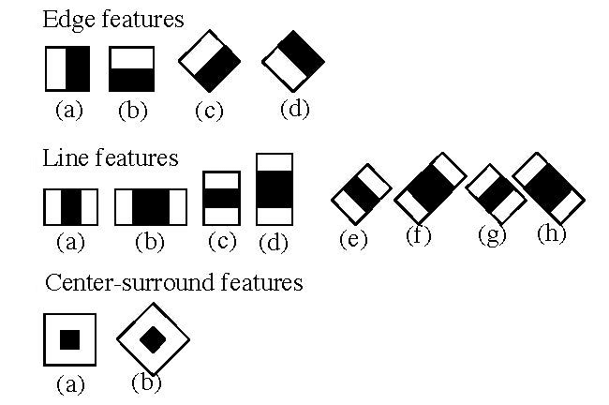

Slide 13
Project Estimation
 | With Average Specs | With High Specs
Laptop/PC | 28-32K | 32K
WebCam | 1K | 5K
Salary of Developers | 5K | 5K
Total Cost of Project | 34-38K | 42K

Slide 14
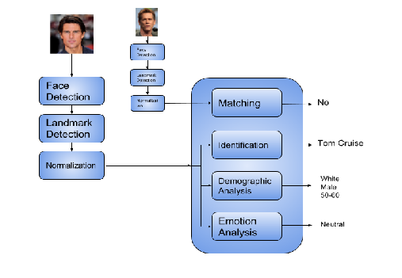
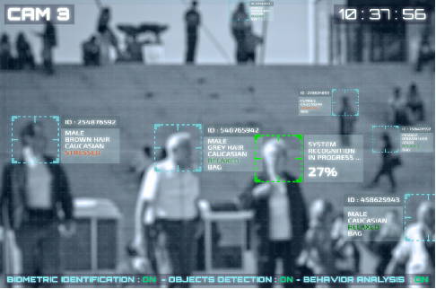
Use-Cases
1. Face Recognition
2. Face Matching in
Surveillance Cams

Slide 15
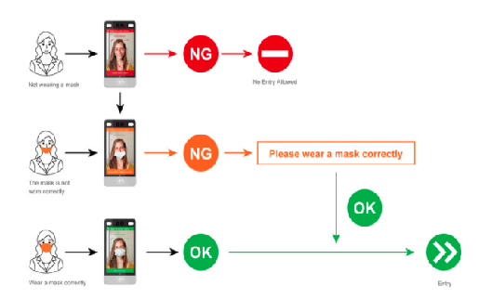
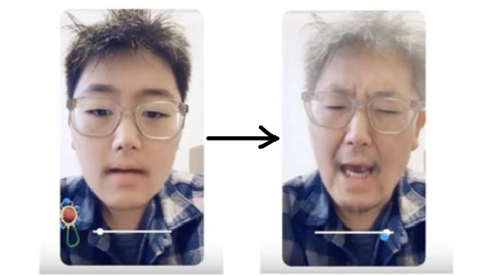
Use-Cases
3. Face Mask Detection
4. Face Filters

Slide 16
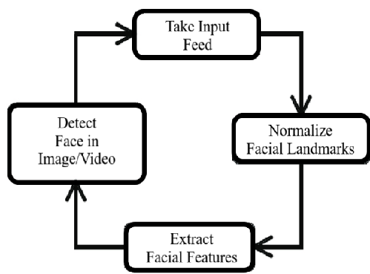
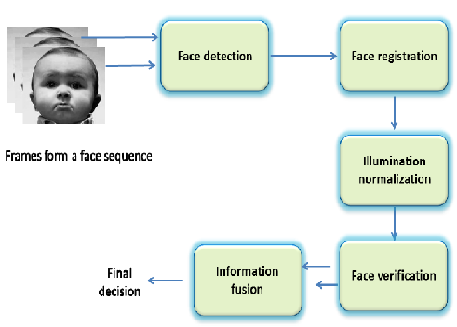
Sequence Diagram

Slide 17
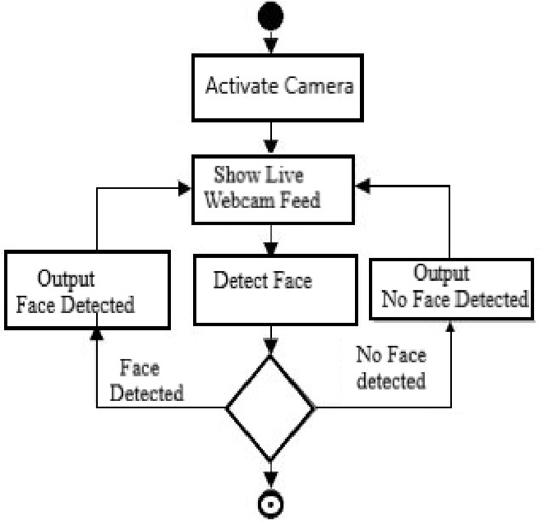
Activity Diagram

Slide 18
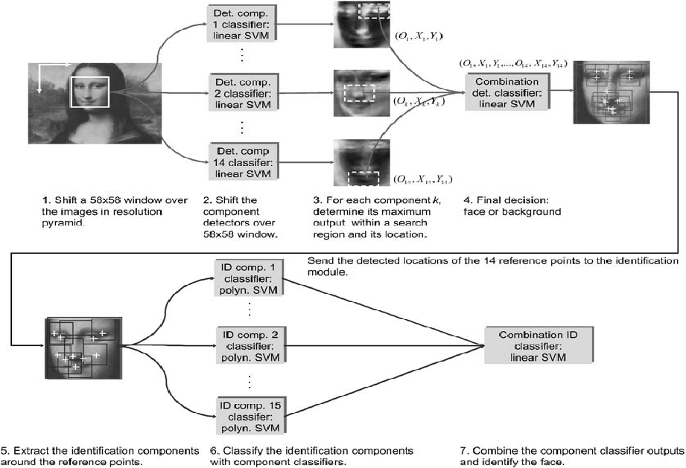
Component Diagram

Slide 19
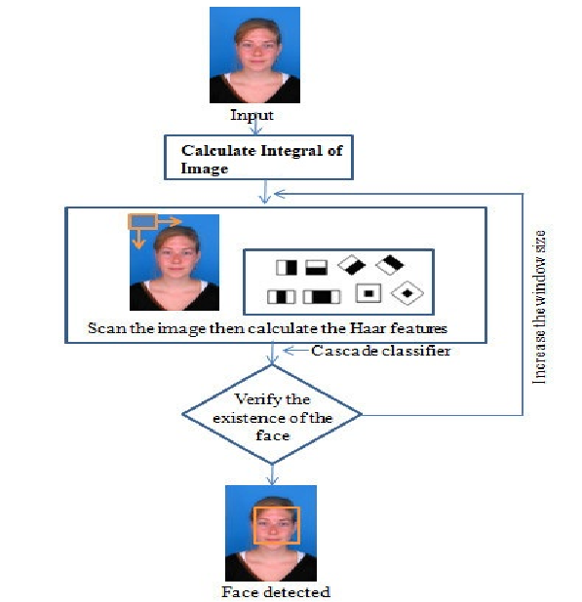
Deployment Diagram

Slide 20
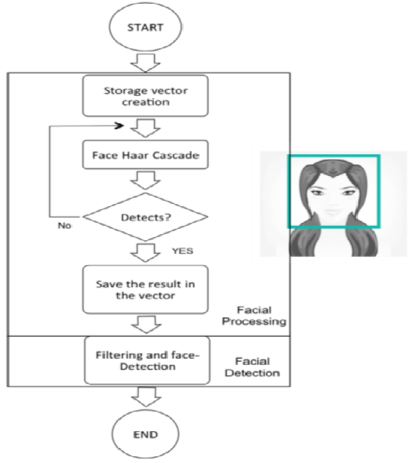
State Machine Diagram

Slide 21
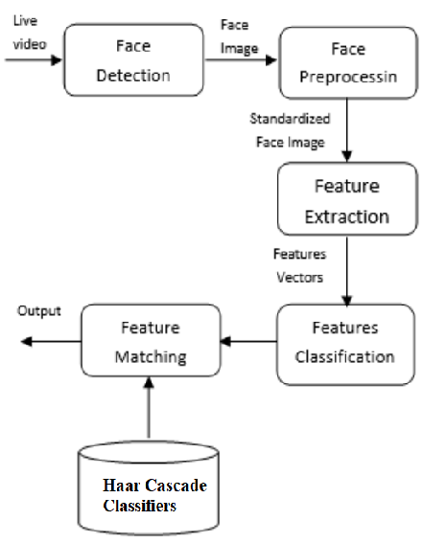
Data Flow Diagram

Slide 22

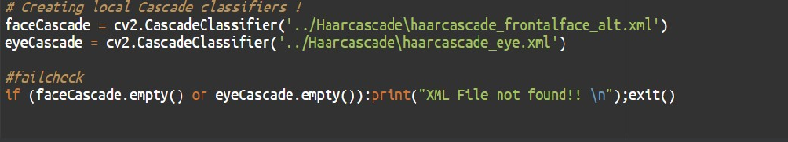
Code Snippets
Importing all Necessary Libraries.
Creating and Loading Cascade Classifiers

Slide 23
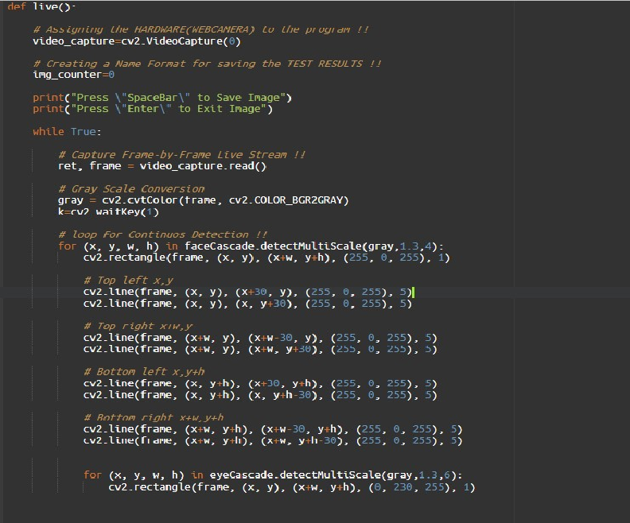
Code Snippets
Loop For Detecting and Comparing Face Cascades

Slide 24
Test Case & Results
Ran several test case against multiple sample images and this model is able to detect every face in every 8 out of 10 images.
Also, ran several test against videos and Live camera feeds and this model was able to detect faces almost 92% accuracy.

Slide 25
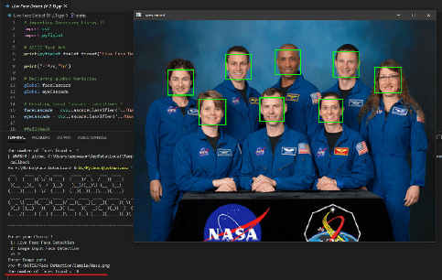
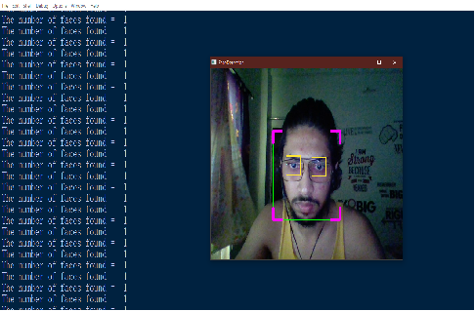
Screenshots
Image feed
2. Live Webcam Feed

Slide 26
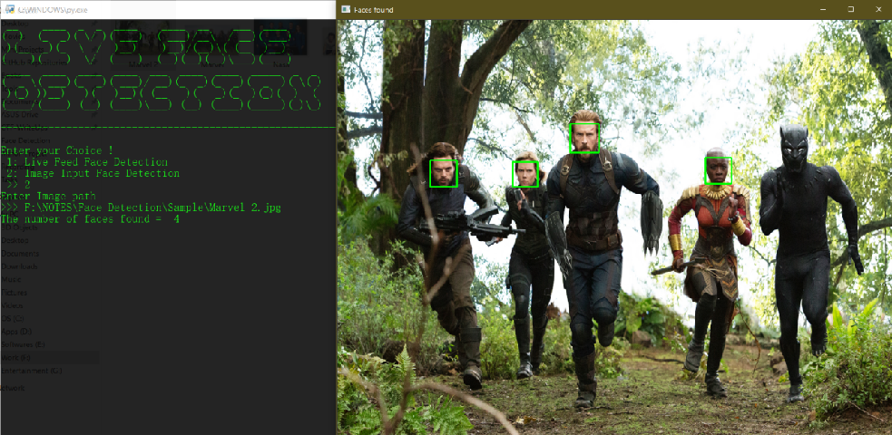
Screenshots
3. Image Feed ( Difficult Light Conditions and black faces)

Slide 27
Limitations
Computationally Complex and Slow.
Less accurate on Black Faces.
Difficulties in unusual lighting conditions.
Less robust to Occlusion.

Slide 28
Future Work
Improve the accuracy with the Black Faces.
Improve the algorithm to work even in difficult lighting conditions.
Work on some techniques to reduce accuracy flaw with Occlusions.
Implement Emotion Analysis and Face Recognition.

Slide 29
Conclusion
Image Processing and Computer Vision is no doubt have grown lot in past few years. Thus it is important to update the Algorithms and ML models.
Haar Cascade is one of the best Algorithm out there but still sometimes lack Accuracy in special conditions.
We have tried to modify and implement the Haar Cascade Model to optimise processing and improve accuracy.

Slide 30
Bibliography
https://docs.opencv.org/master/db/d28/tutorial_cascade_classifier.html
https://www.superdatascience.com/blogs/opencv-face-detection/
https://stackoverflow.com/questions/15482763/face-detection-accuracy-using-opencv-and-python
https://towardsdatascience.com/whats-the-difference-between-haar-feature-classifiers-and-convolutional-neural-networks-ce6828343aeb

